Slide 1
CELEBRATING
75 YEARS OF COMMUNICATION
1947-2022

Slide 2
Over 11,000 Alumni
The Department by the numbers:

Slide 3
44 Teaching Excellence Awards
The Department by the numbers:
22 Faculty & 22 Graduate Students

Slide 4
4 University Scholars
The Department by the numbers:
Dale Brashers (2004), Leanne Knobloch (2015), Cara Finnegan (2017), and Ned O’Gorman (2020).

Slide 5
3 Excellence in Undergraduate Academic Advising Awards
The Department by the numbers:

Slide 6
History of the Communication Department
1947-2022

Slide 7
1947
History of Our Department
The Division of Speech splits from the Department of English to become the:
Department of Speech

Slide 8
1947
History of Our Department
Karl R. Wallace becomes the first Head of the Department and served in this position for 21 years.

Slide 9
1947
History of Our Department
“The decision to create a separate department was taken because of the unwieldiness of the Department of English with Speech in it…In short, it was simpler to have a department than not to have one.”
- Karl Wallace

Slide 10
1947
History of Our Department
The new department was organized into five areas:
Rhetoric &
Public Speaking
Interpretation & Radio
Speech Science, Phonetics, & Correction
Teacher Training & Speech Education
Theatre

Slide 11
1951
History of Our Department
The first Ph.D. in speech was granted to George Washington Cartwright

Slide 12
1960
History of Our Department
The Department of Speech becomes the:
Department of Speech and Theatre

Slide 13
1961
History of Our Department
Due to the department’s expansion of social science research, it becomes part of both the Division of Social Sciences and the Division of Humanities in LAS.

Slide 14
1967
History of Our Department
The Department of Theatre is formed, but many theatre courses remain in the Department of Speech which considers offering a PhD in Theatre.

Slide 15
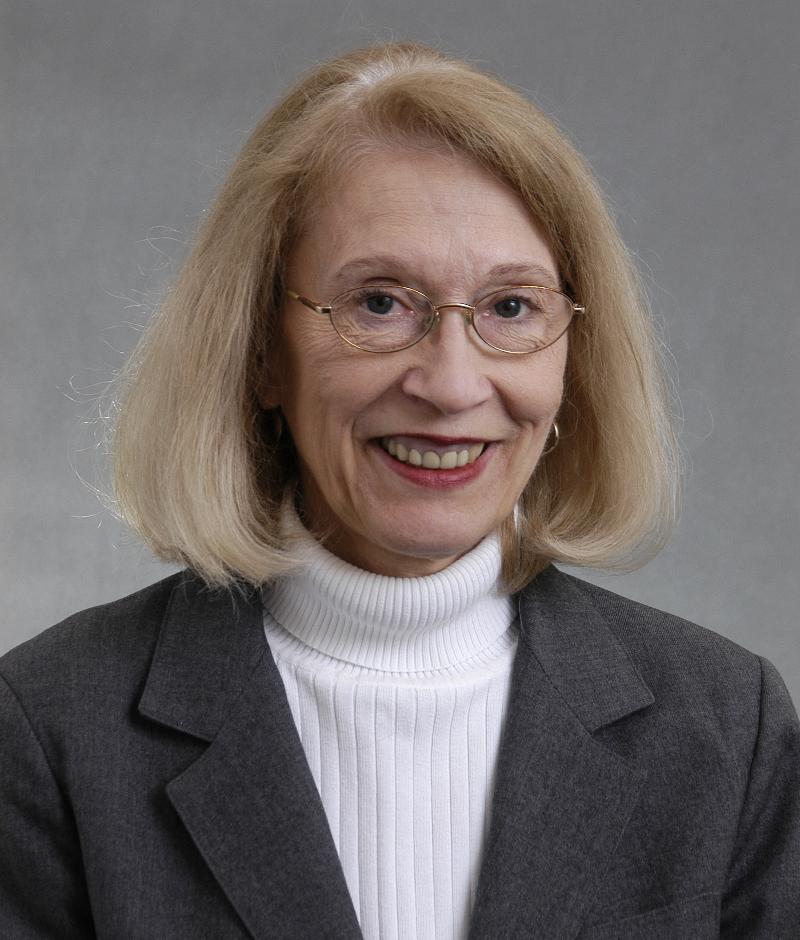
1967
History of Our Department
“With the arrival from Cornell of Professor Ruth Anne Clark in psycholinguistics, we shall be appreciably strengthened in empirical studies.”
– 1967 Department Newsletter

Slide 16
1968
History of Our Department
Proposal is developed to reorganize the Speech Correction area as a separate department.
Department rejects proposal to change name to “Department of Communicative Arts and Sciences.”

Slide 17
1969
History of Our Department
Roger Nebergall becomes the second Head of the Department and served in this position for 9 years.

Slide 18
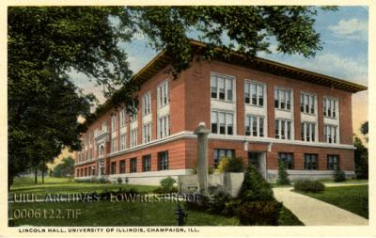
1971
History of Our Department
Department offices are consolidated in Lincoln Hall.

Slide 19
1975
History of Our Department
The Department dramatically restructures its debate and forensics area to “provide broadly based training for large numbers of students rather than to that which provides intensive activity for a few.”

Slide 20
1973
History of Our Department
The Speech and Hearing Science division becomes its own department. The Department of Speech becomes the:
Department of Speech Communication

Slide 21
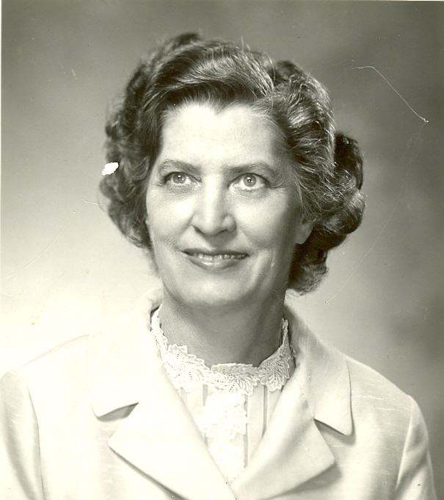
1976
History of Our Department
Marie Hochmuth Nichols retires after 37 years as a faculty member. She had also served as the President of the Speech Association of America (now called NCA).

Slide 22
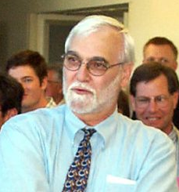
1978
History of Our Department
Jesse Delia becomes the third Head of the Department.

Slide 23
1984
History of Our Department
The faculty vote to establish the Illinois Tradition Awards. The awards are named after former faculty who played especially important roles in building the Department.

Slide 24
1988
History of Our Department
With an increase in undergraduate majors, Barbara Hall is hired as the first full-time academic advisor.

Slide 25
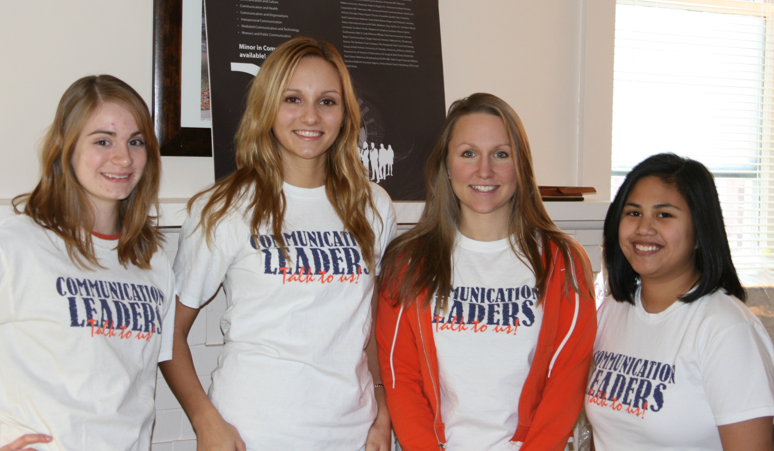
2006
History of Our Department
The first group of Communication Leaders become undergraduate ambassadors for the department.

Slide 26
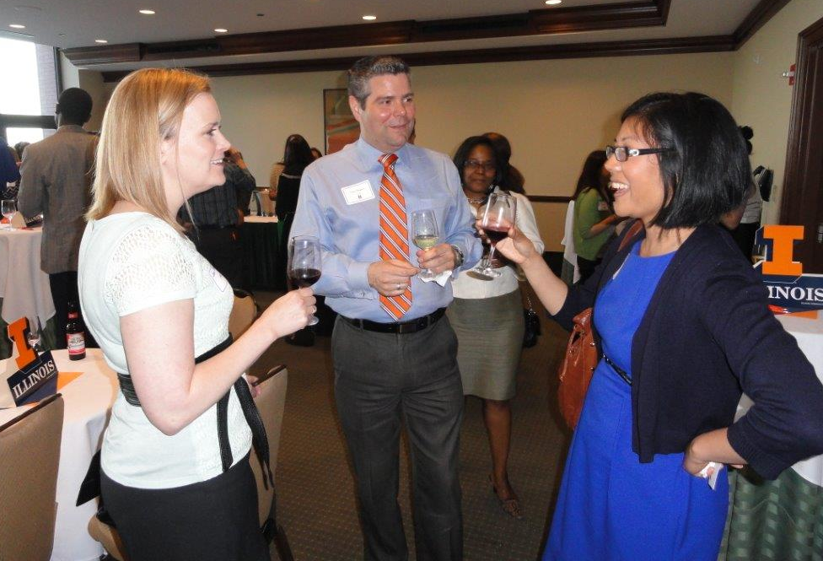
2006
History of Our Department
The Department established an Alumni Advisory Council to strengthen ties between alumni across the country.

Slide 27
2009
History of Our Department
After years of debate, the Department of Speech Communication changes its name to the:
Department of Communication

Slide 28
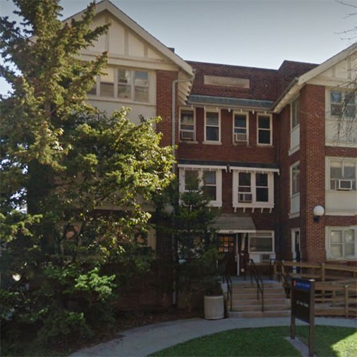
2009
History of Our Department
The department moves its offices to 1207 Oregon St. while Lincoln Hall is renovated.

Slide 29
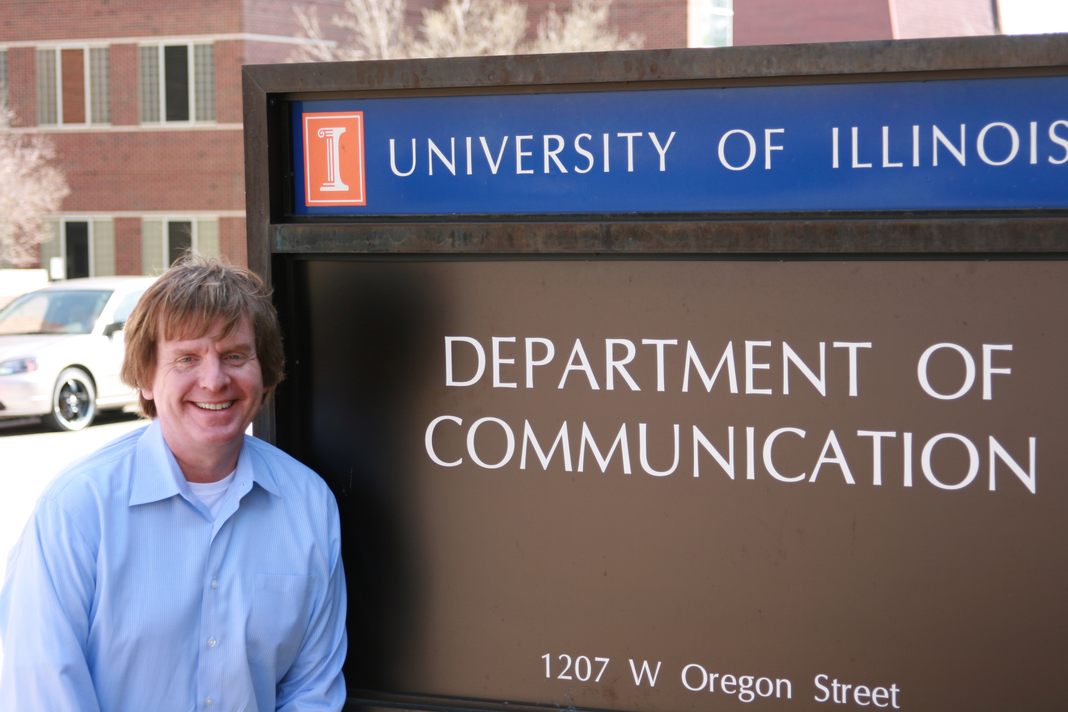

Slide 30
2010
History of Our Department
The department launches its online MS program in Health Communication, one of the first online programs on campus.

Slide 31
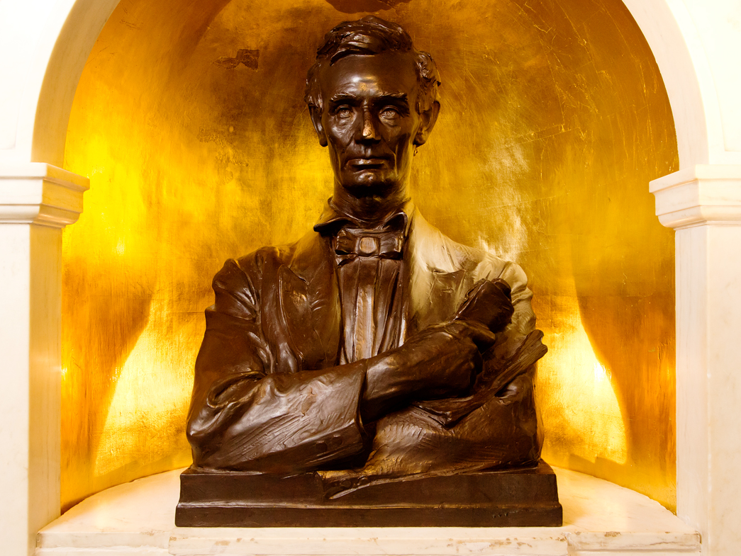
2012
History of Our Department
For the first time in 65 years, the whole department is in one building as everyone moves back into Lincoln Hall.

Slide 32
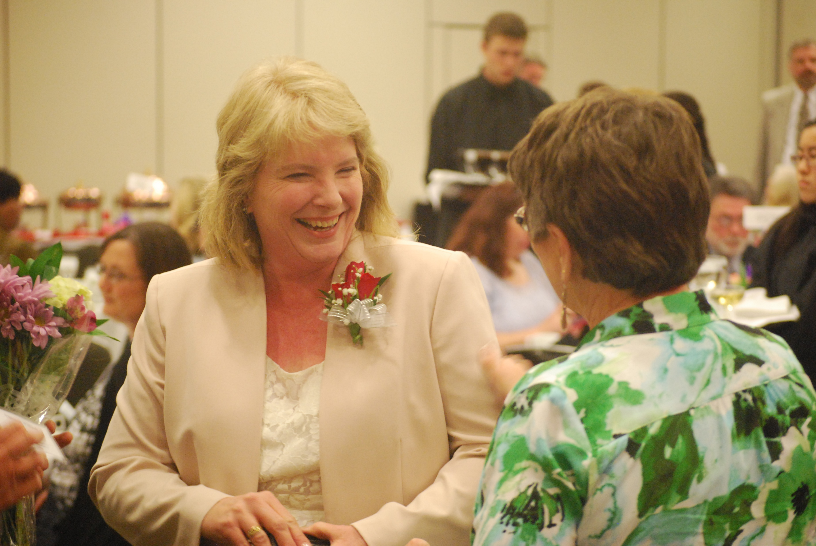
2014
History of Our Department
Mary Strum won the Chancellor’s Distinguished Staff Award for outstanding service to the university after winning the LAS Staff award the year before.

Slide 33
2016
History of Our Department
The Department became a Certified Green Office, joining the university’s initiative to be carbon neutral by 2050.

Slide 34
2023
History of Our Department
The Communication Department celebrates 75 years!

Slide 35
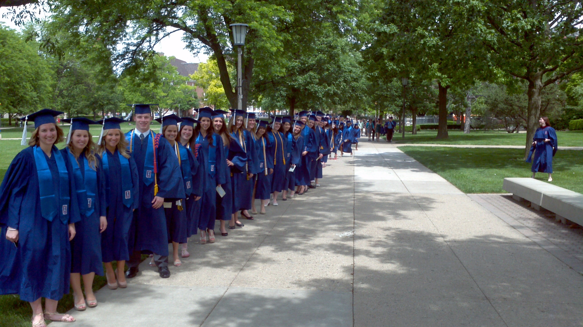

Slide 36
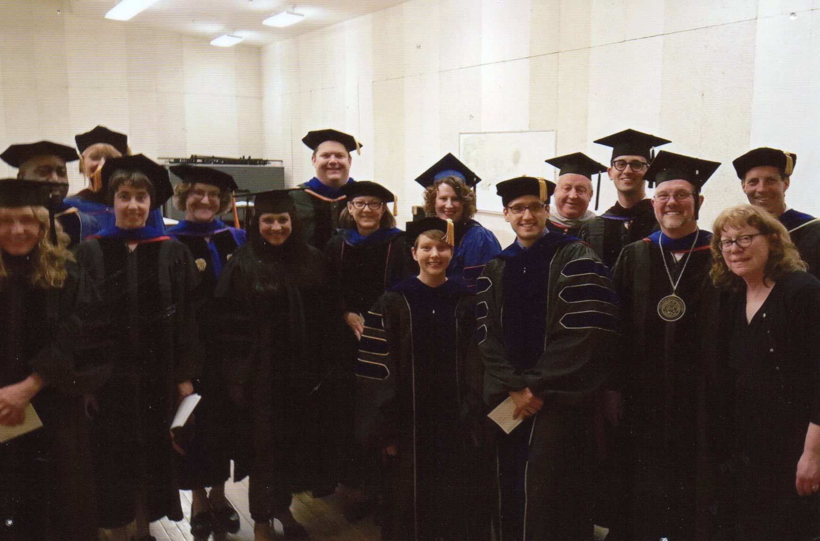

Slide 37
Lincoln Hall Through The Years
1913-2022

Slide 38
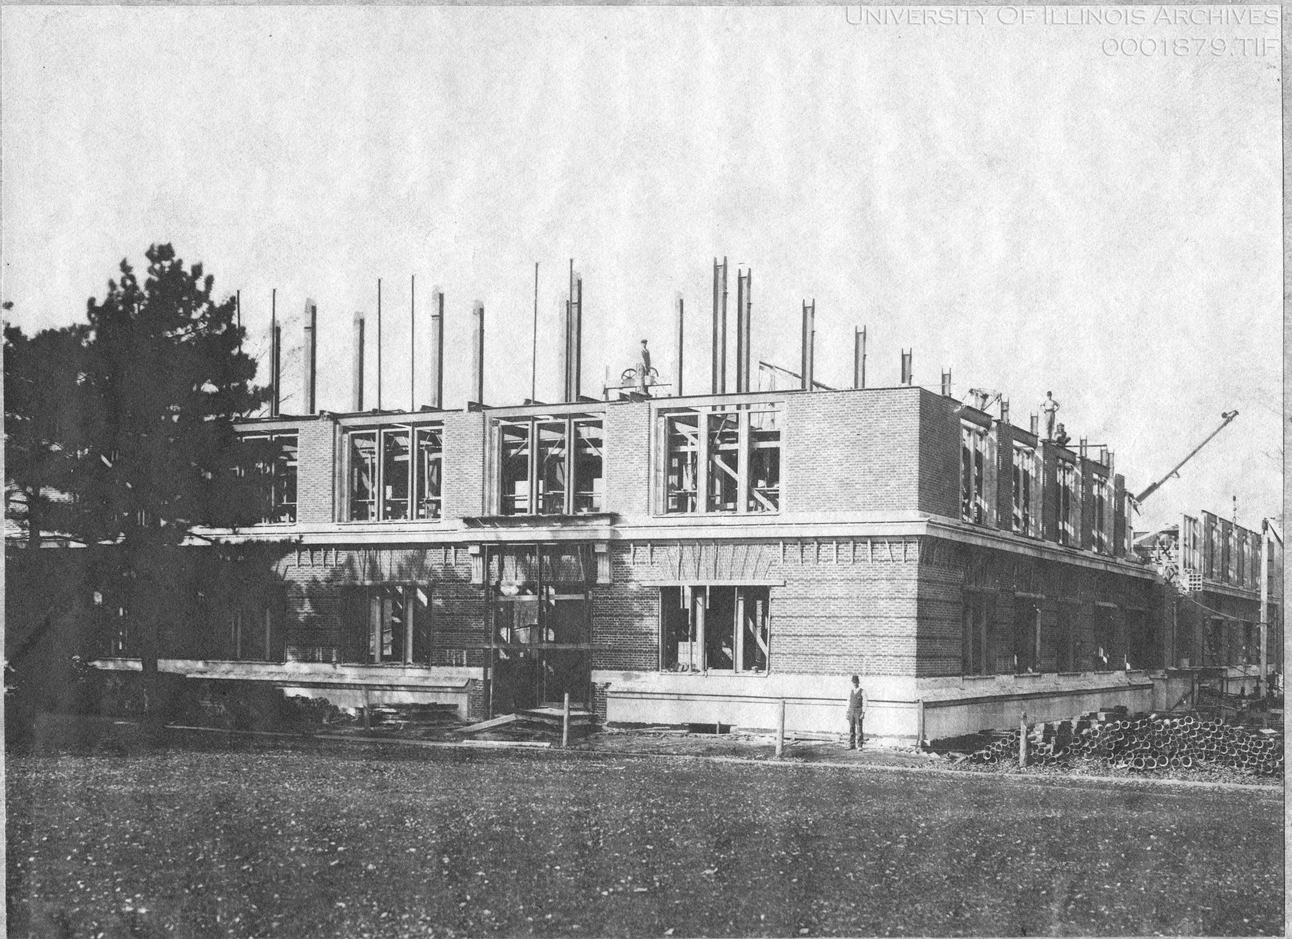

Slide 39
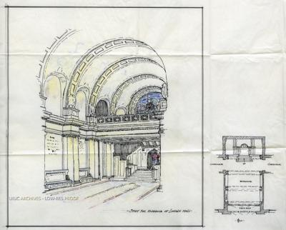

Slide 40
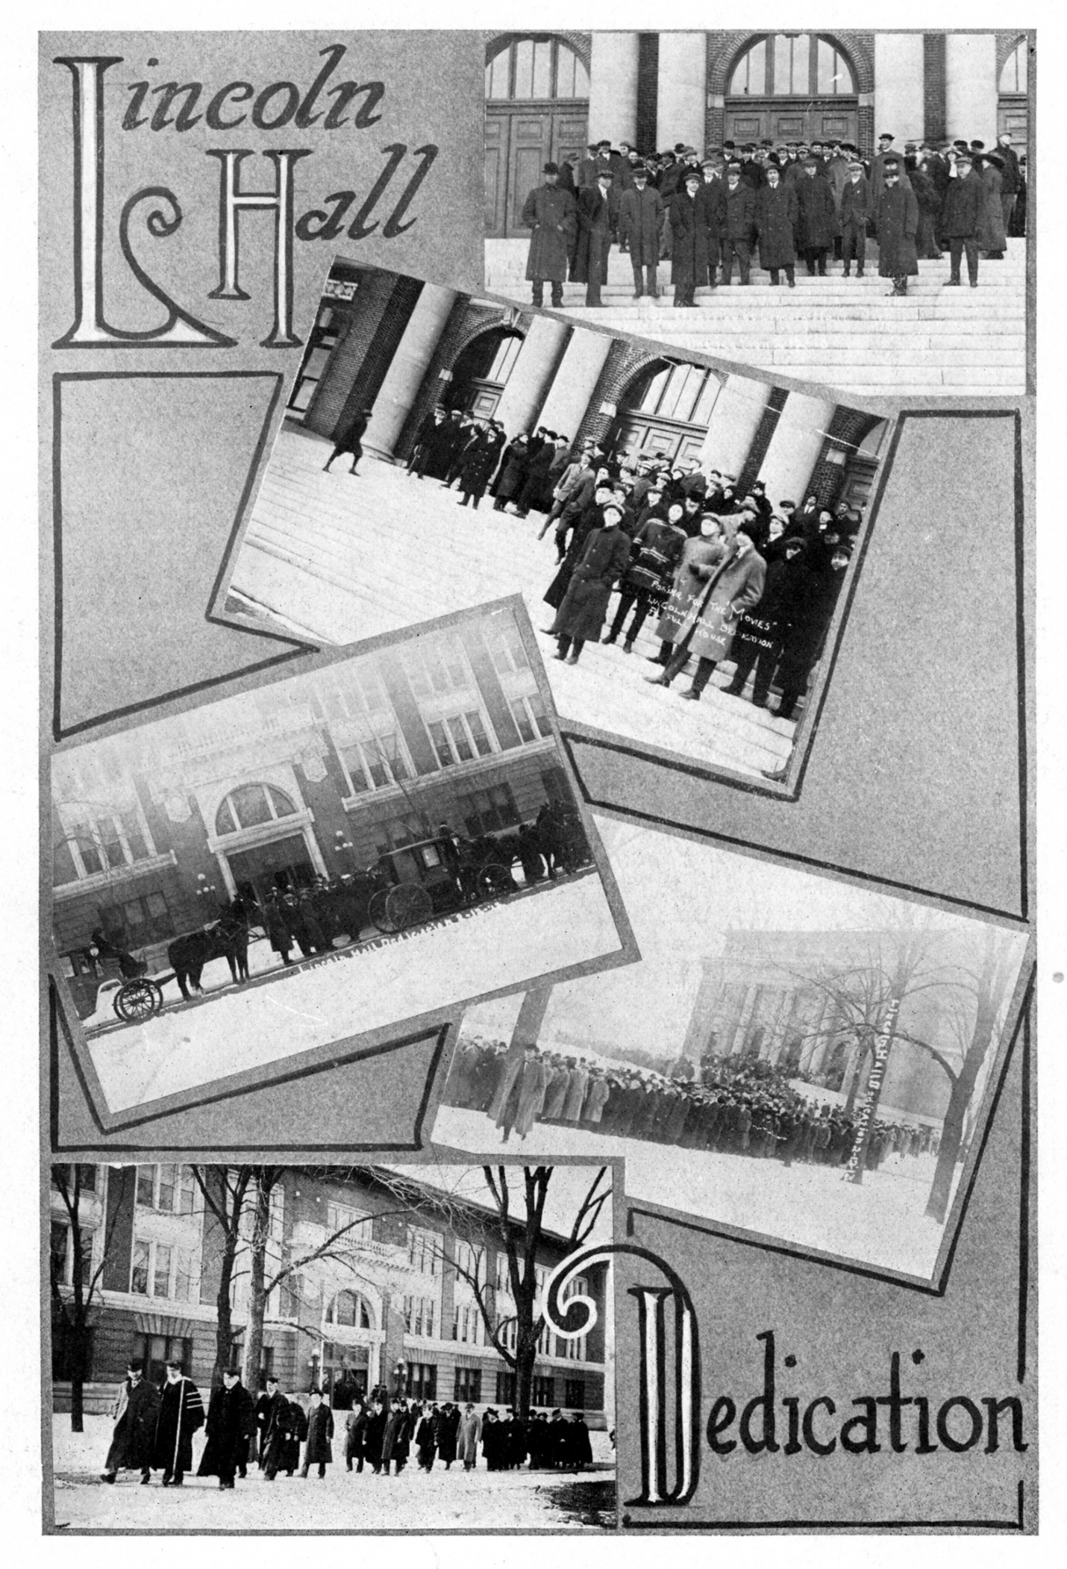
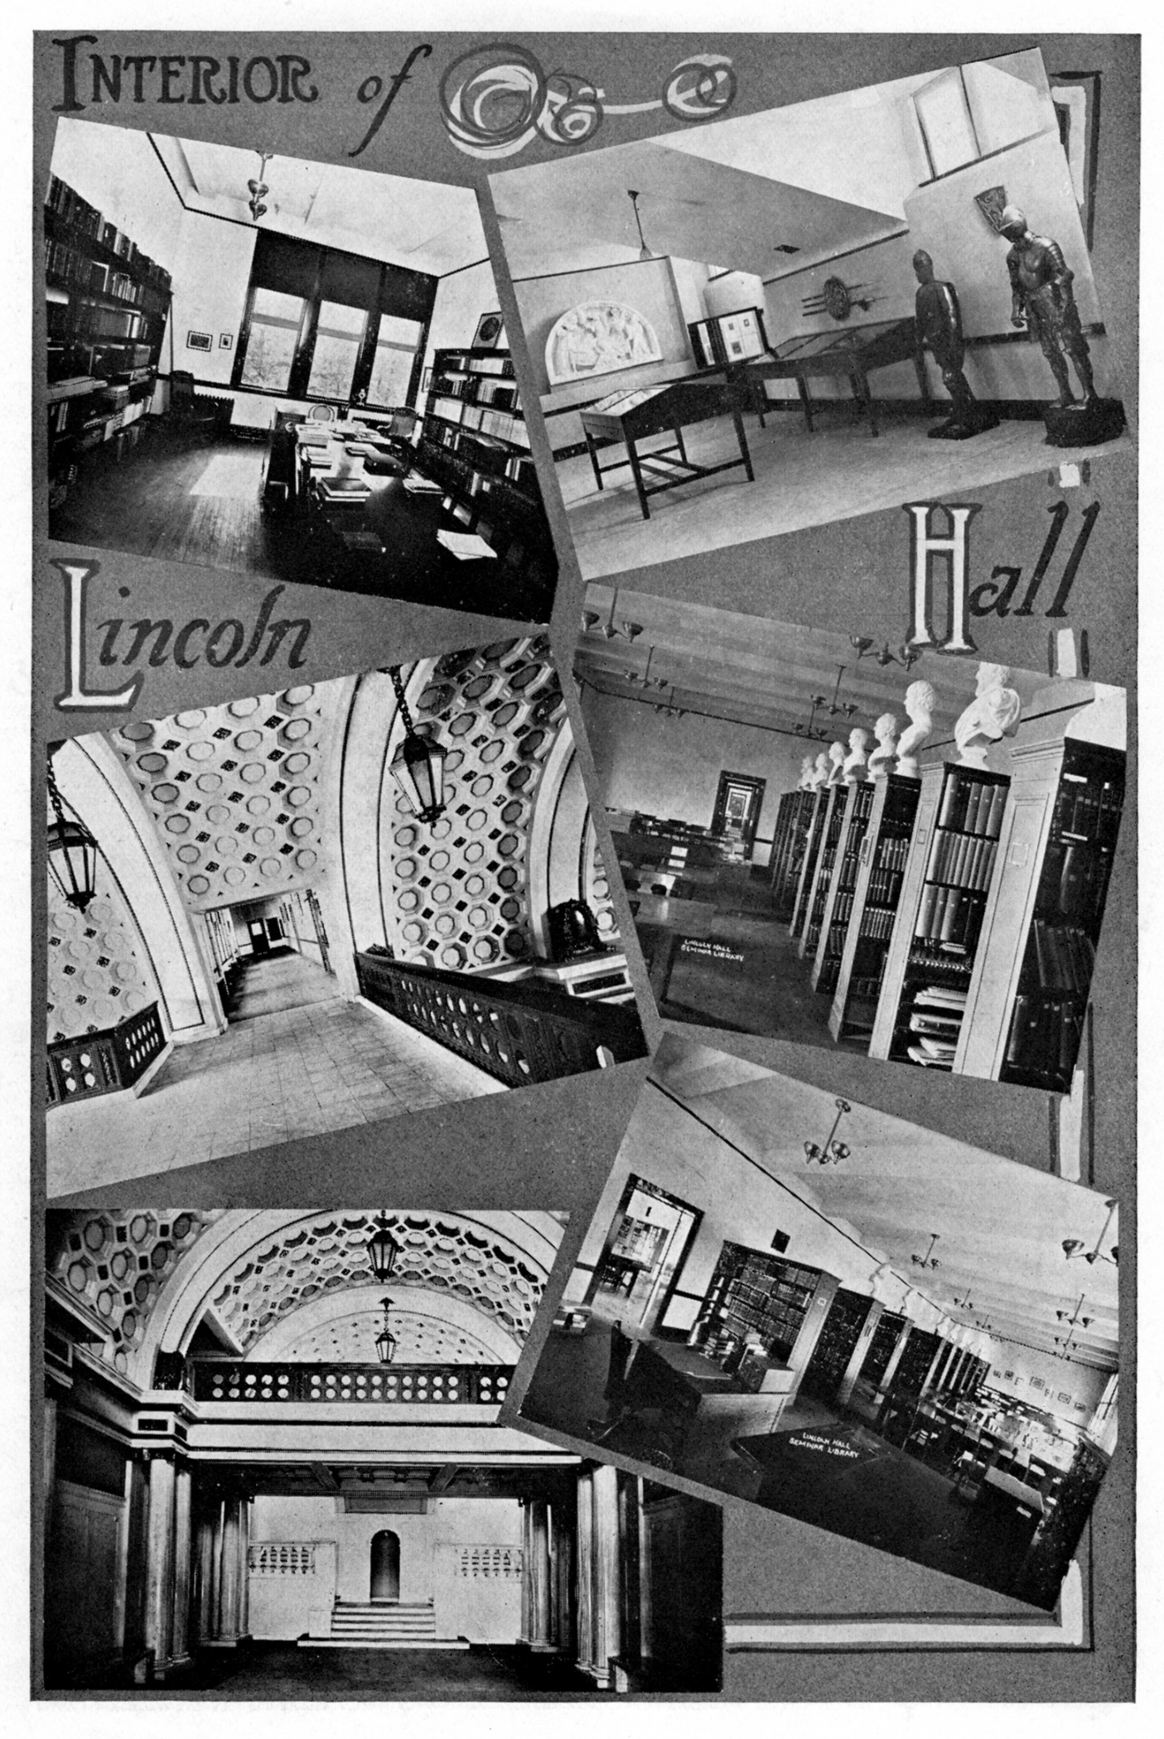

Slide 41
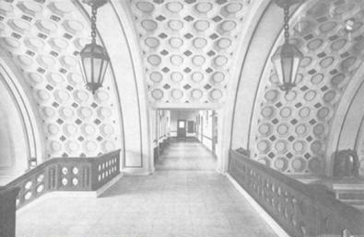

Slide 42
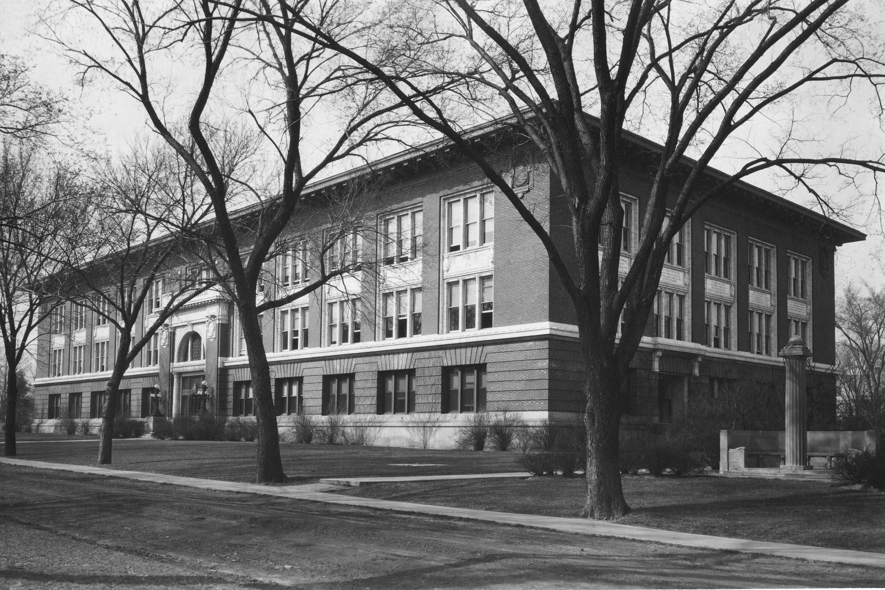

Slide 43
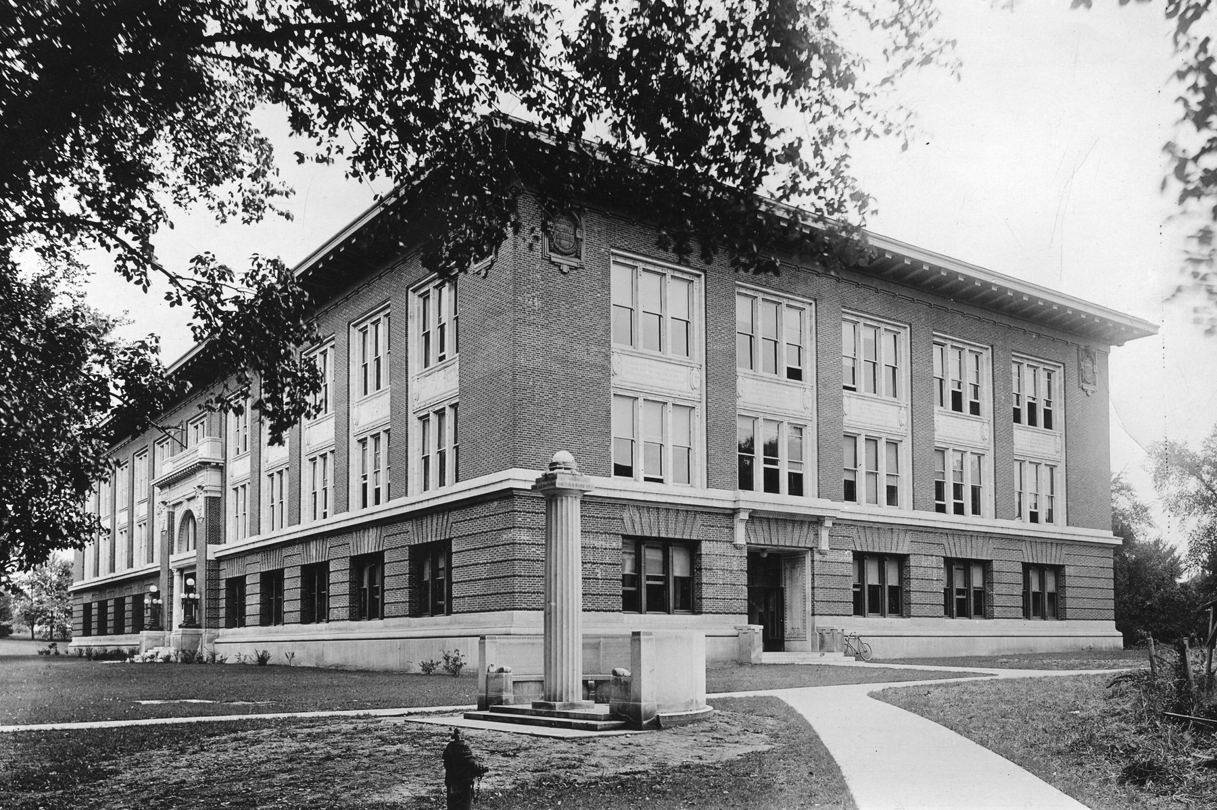

Slide 44
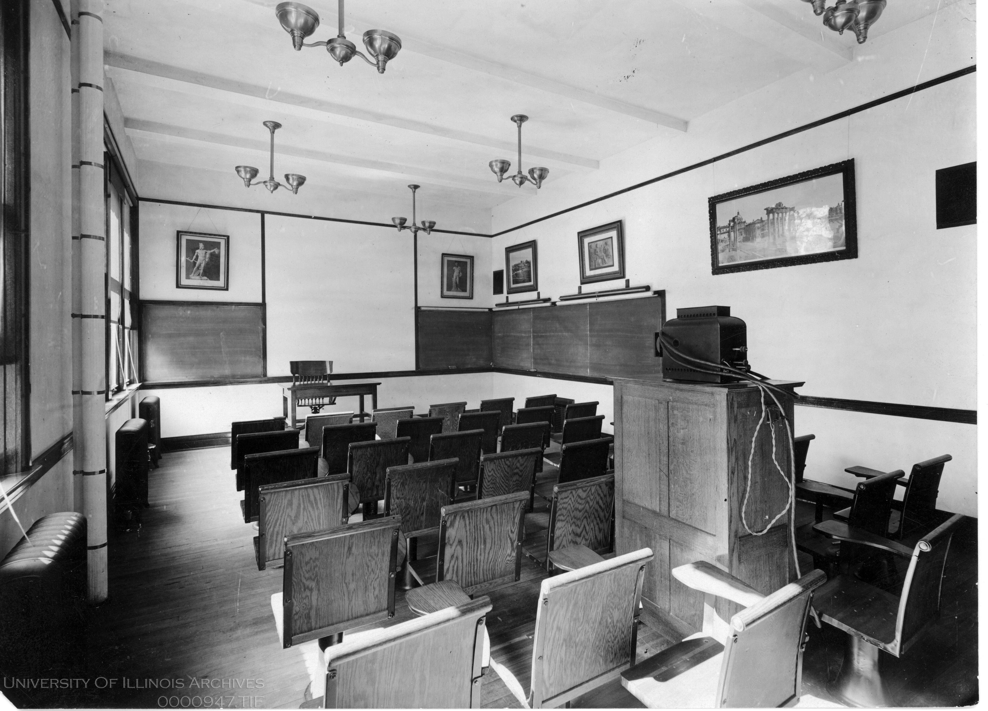

Slide 45
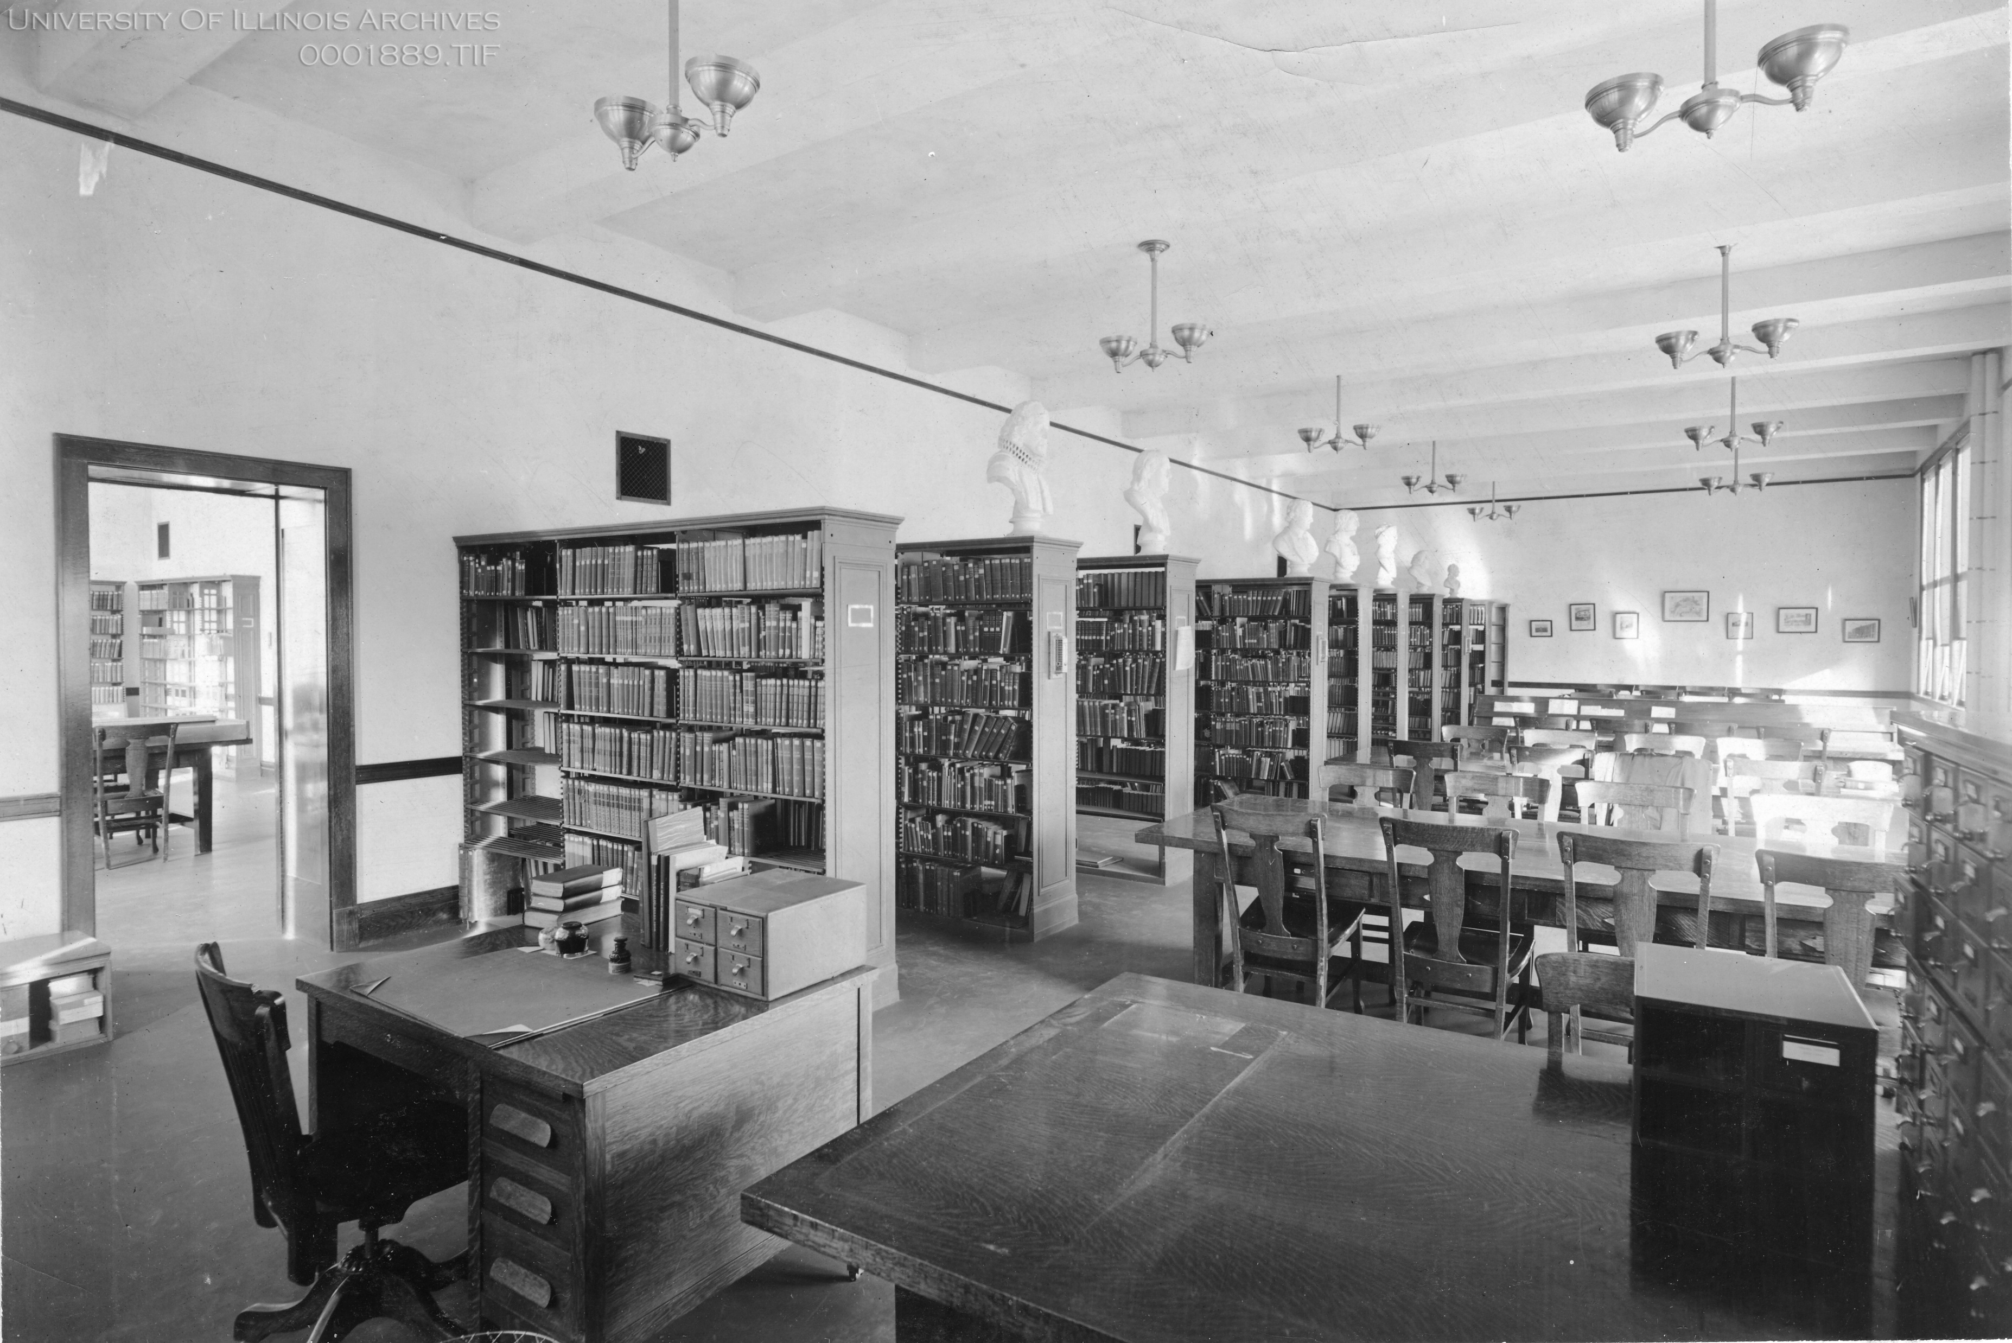

Slide 46
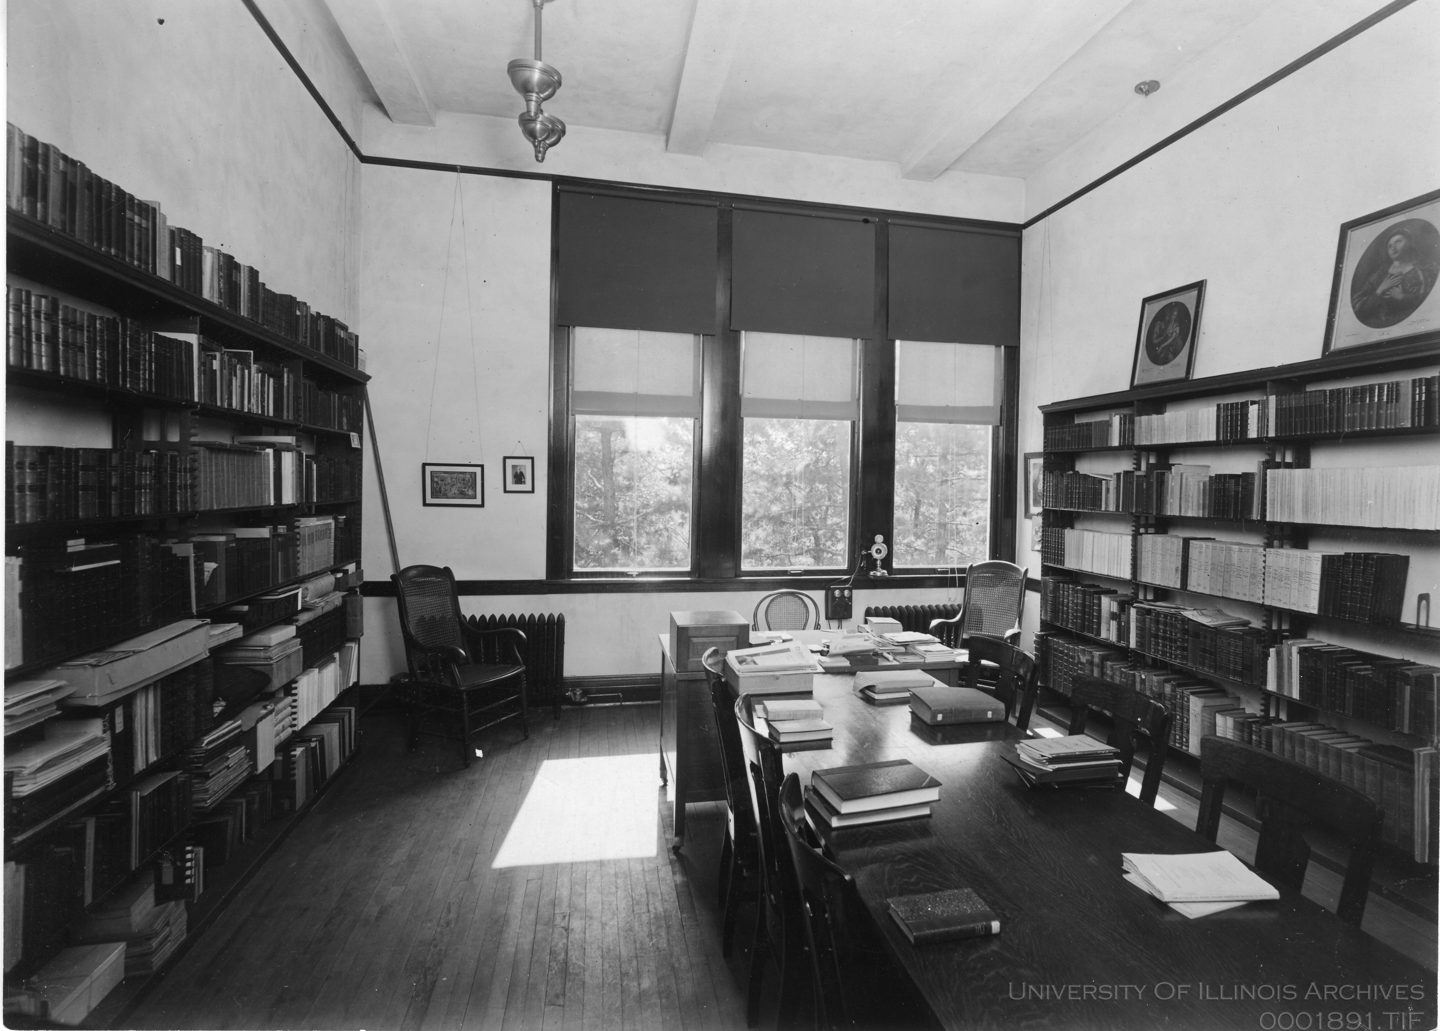

Slide 47
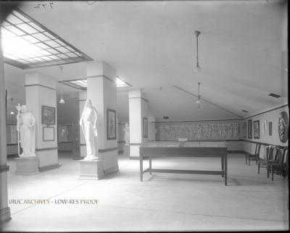

Slide 48
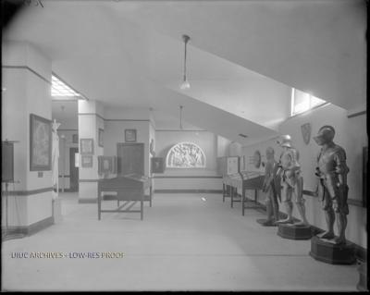

Slide 49
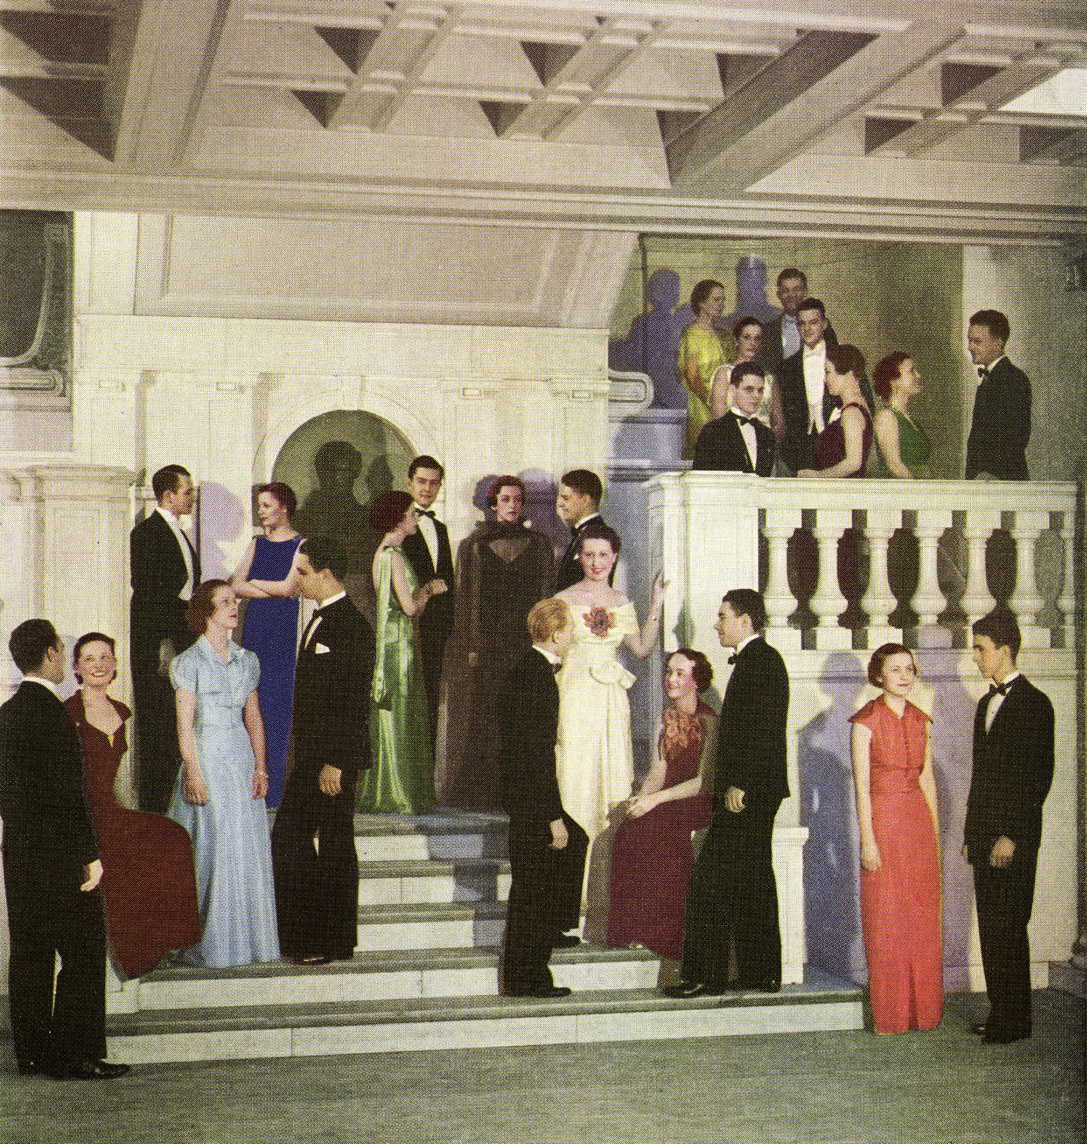

Slide 50
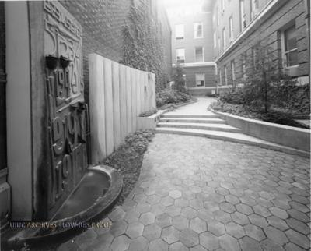

Slide 51
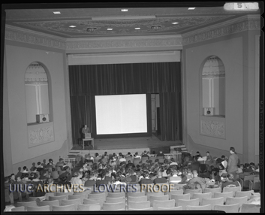

Slide 52
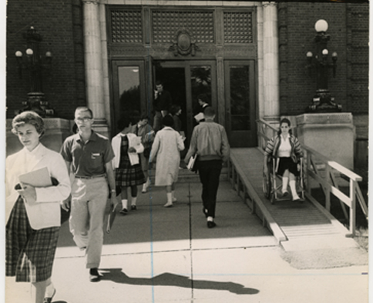

Slide 53
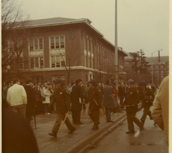

Slide 54
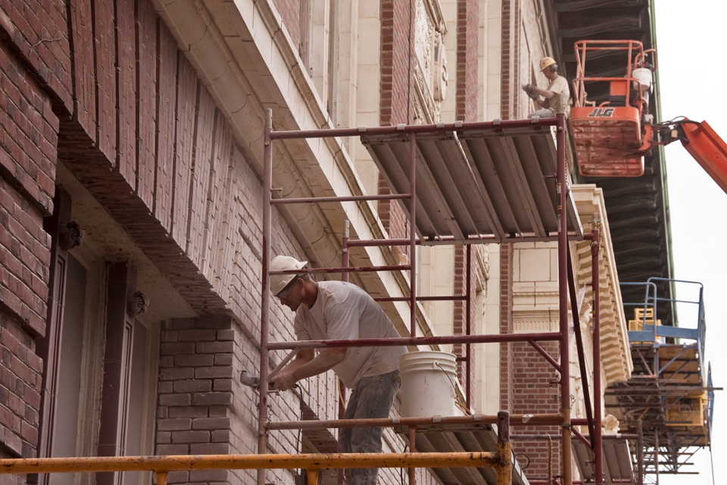

Slide 55
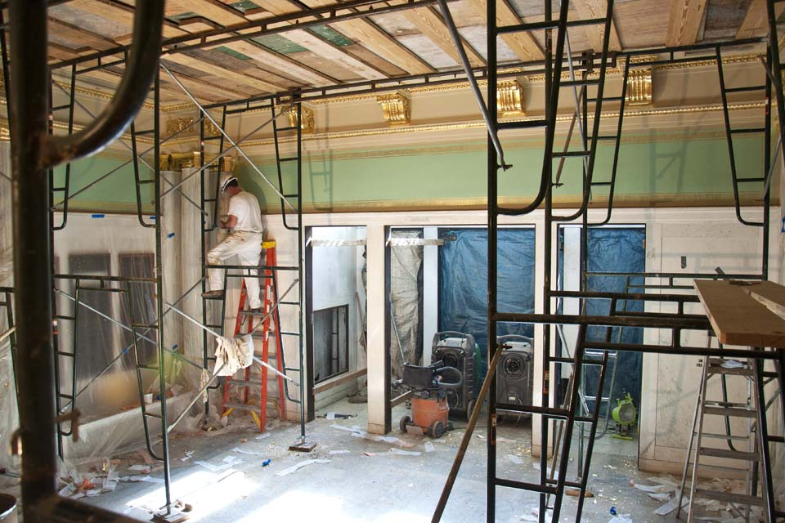

Slide 56
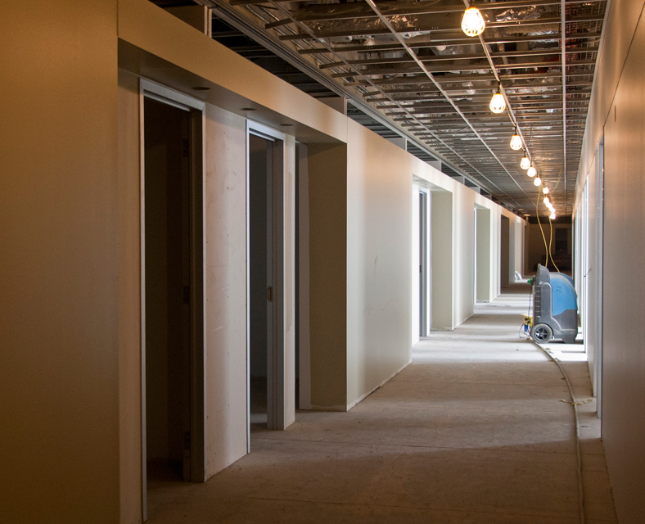

Slide 57
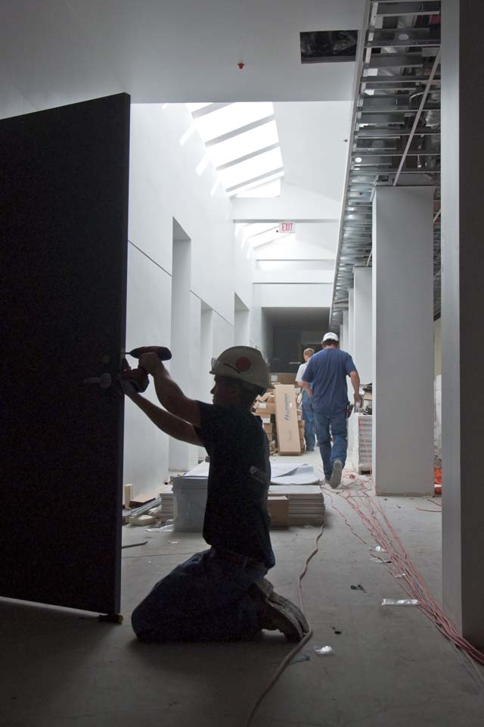
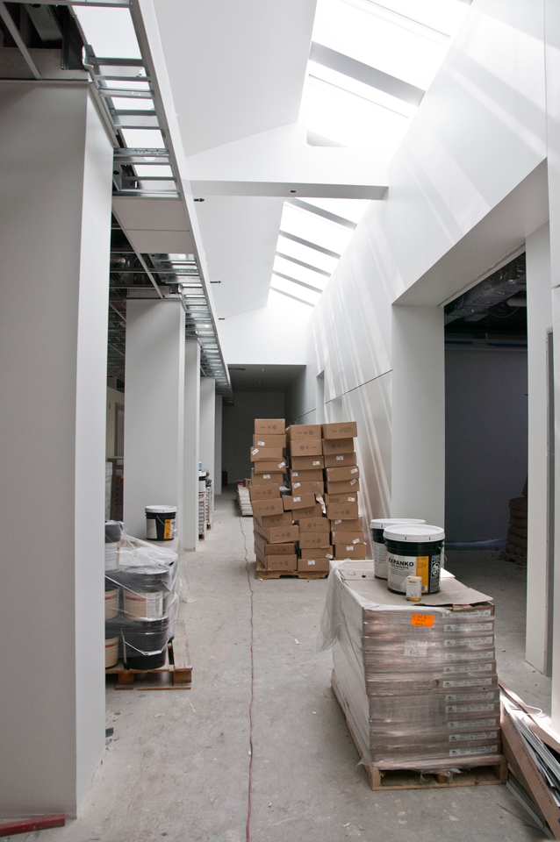

Slide 58
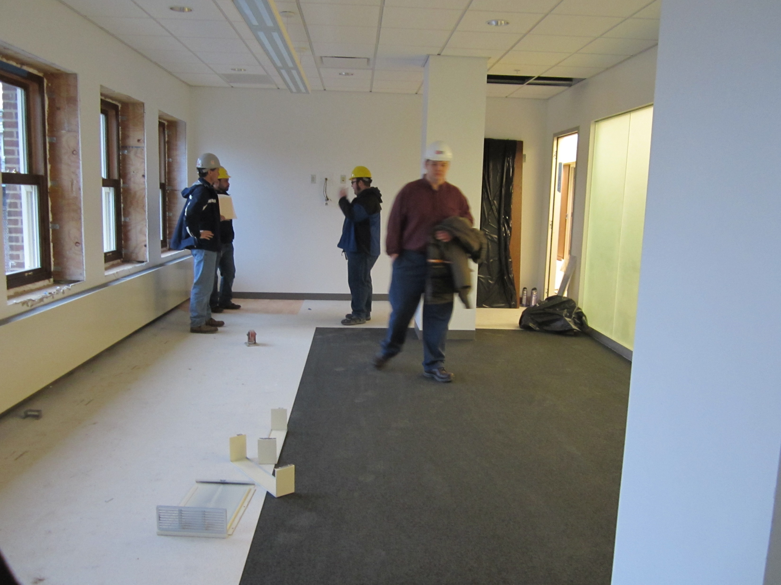

Slide 59
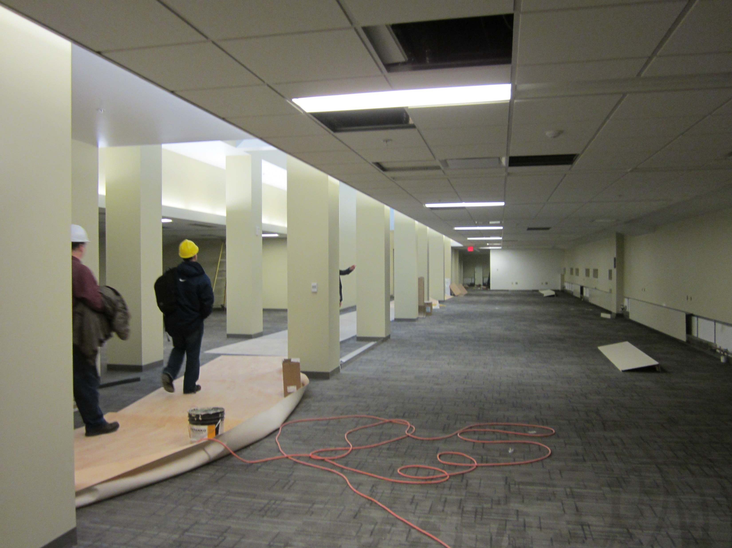

Slide 60
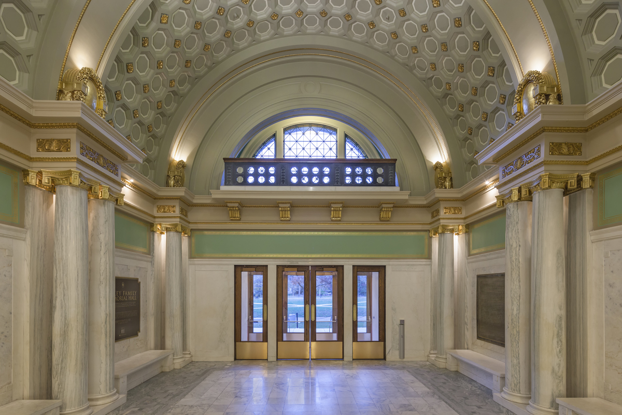

Slide 61
